Slide 1

Amazon Sales Analysis
Emma Li, Barrett Ottenberg and Matthew Warner

Slide 2
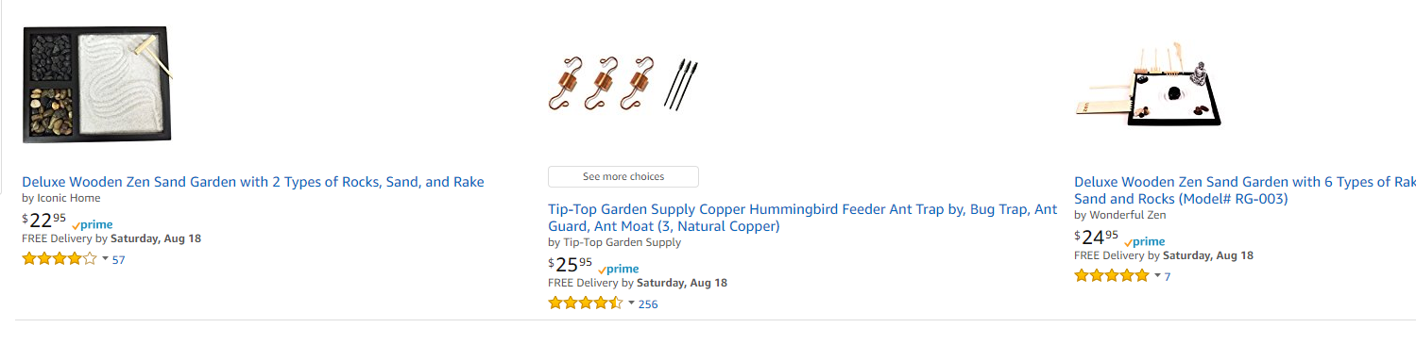
Project: Amazon Sales Analysis
Matthew has a small business and uses Amazon.com as a sales channel.
Project is to explore sales and advertising data to find trends
Migrate away from Excel
Foundation for actual business use
Data has been masked
Real Data but it has been scaled for privacy

Slide 3

Raw Data
Data is from Amazon.com sales
CSVs came from Amazon.com reports
API Available but complex
Three datasets were used
Transactional sales data (26k rows)
Advertising data (3k rows)
Cost of Goods data ( 50 rows)
Data limitations
Only ~70 days worth of advertising data was used
Due to Amazon file change and to keep it simple
Missing some insightful data,
# of Reviews and Review Score
Similar competitor prices
Sales rank
Keyword rankings

Slide 4
Data Cleanup
Merge into 2 master dataframes
All other queries were ran on these dfs
Convert STR to appropriate datatype (int, datetime, float etc.. )
Converting timestamps to dates was critical
A lot of data was grouped by dates
Very challenging to work with time.
Time zone aware vs naïve
Many libraries to deal with time data. (None of them great)
Convert strings with % to floats
Many times errors were not obvious until plotting steps
Caused a lot of recoding

Slide 5
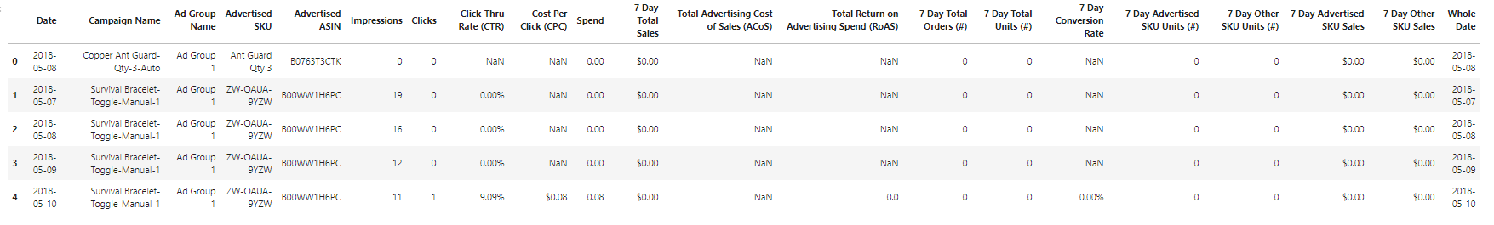
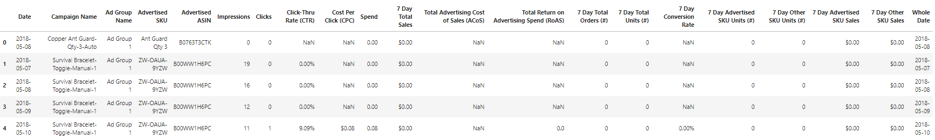
Clean Data
Transaction Data + Cost of Goods Merged
Advertising Data

Slide 6
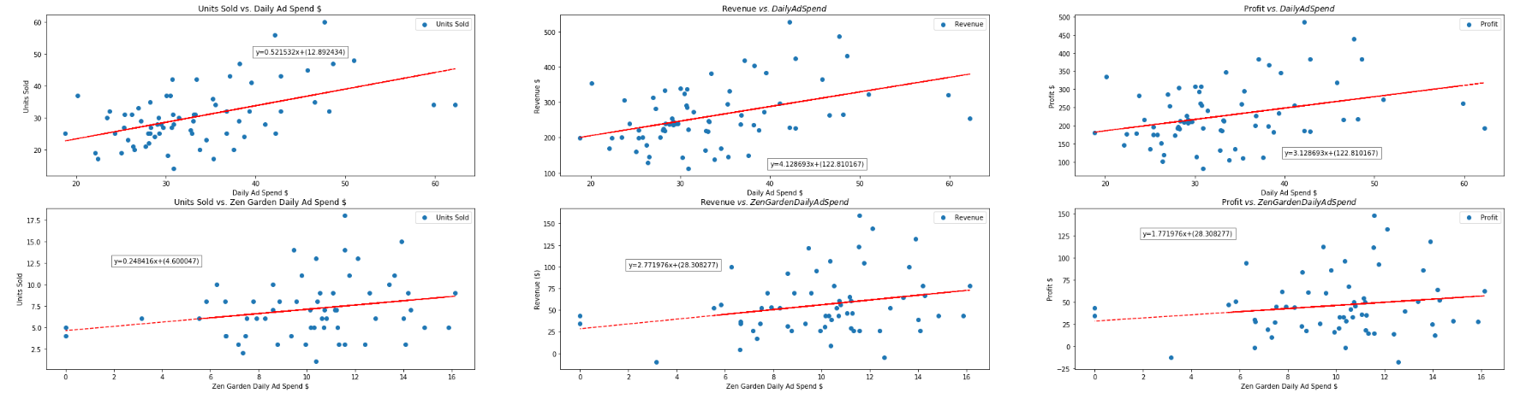
Does advertising in this dataset always increase sales? Hypothesis: No
There is a positive correlation between ad spend and units sold, revenue and profit.
This suggests higher ad spend correlates with higher sales.
May be worth exploring ad spend higher and lower than this dataset.
Hypothesis was not supported by this dataset.
Products may need to be evaluated on an individual basis.

Slide 7
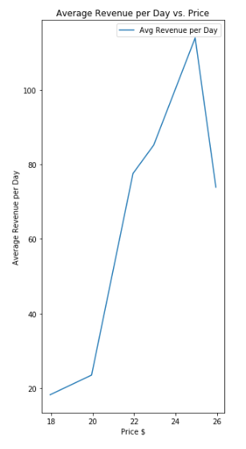
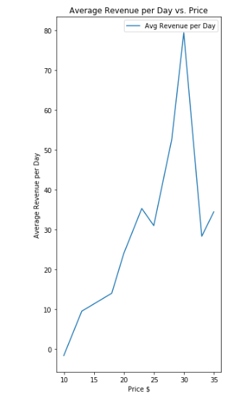
Does lowering price in this dataset always increase revenue? Hypothesis: No
Price Optimization
Two Products
There is a correlation between price and revenue.
Low price and high price yields lower revenue.
Data suggests there is an optimal price range.
Many small business aren’t doing these tests and could be losing $$$.
Hypothesis was supported.

Slide 8
Do products used during summer sell better during warmer months?
Hypothesis: Yes

Slide 9

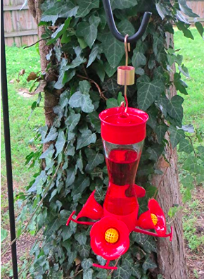
Do products used during summer sell better during warmer months? Hypothesis: Yes
What products are used during summer ?
Which months are warmer months?
Copper Hummingbird Feeder Ant Guard by Tip-Top Garden Supply
Warmer months= summer

Slide 10
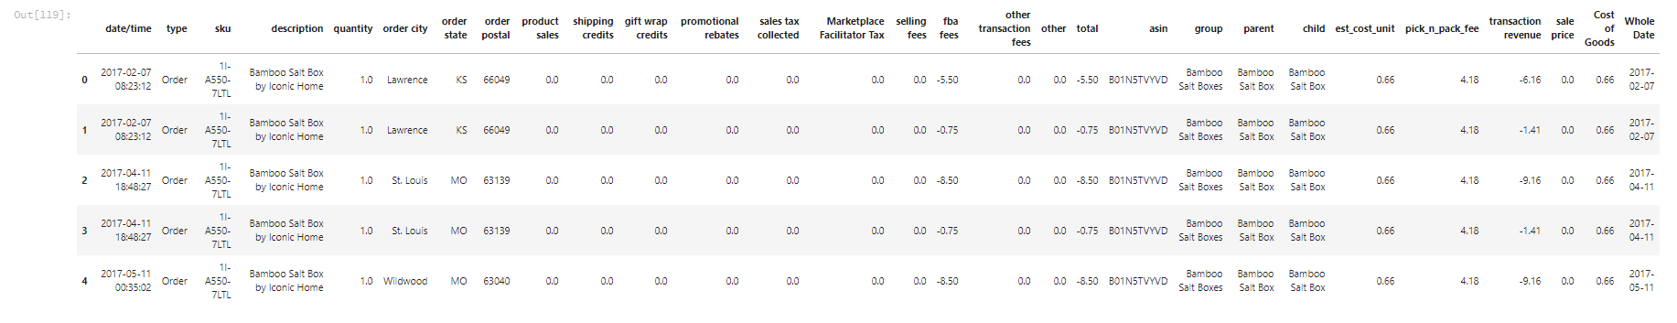
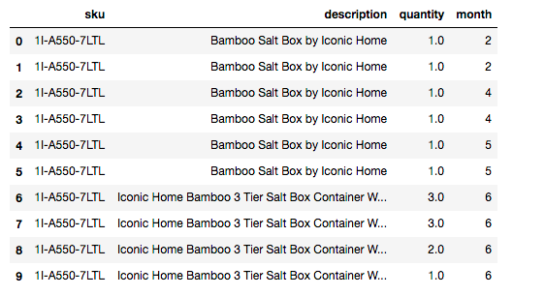
Tidy up Data again
Do products used during summer sell better during warmer months? Hypothesis: Yes
Only keep the columns we need:
SKU, description , Quantity, month

Slide 11
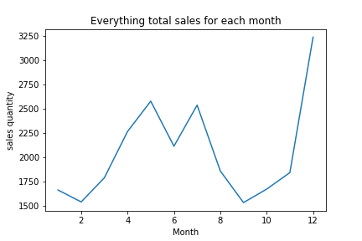
Do products used during summer sell better during warmer months? Hypothesis: Yes
Total 79 items.
2 trends
increased sales from April to August
Another is in December

Slide 12
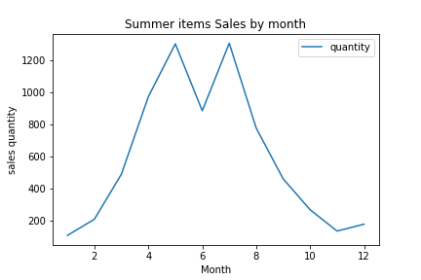
Do products used during summer sell better during warmer months? Hypothesis: Yes
Summer item:
Ant Guard
The sales were boosted during the summer months, from June to August.
The ramp-up started in the spring.

Slide 13
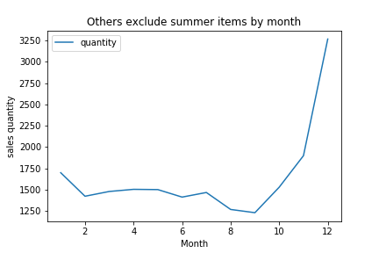
Do products used during summer sell better during warmer months? Hypothesis: Yes
Others exclude summer items sales
Increase from Oct., forward
clear trend during the Christmas season.

Slide 14
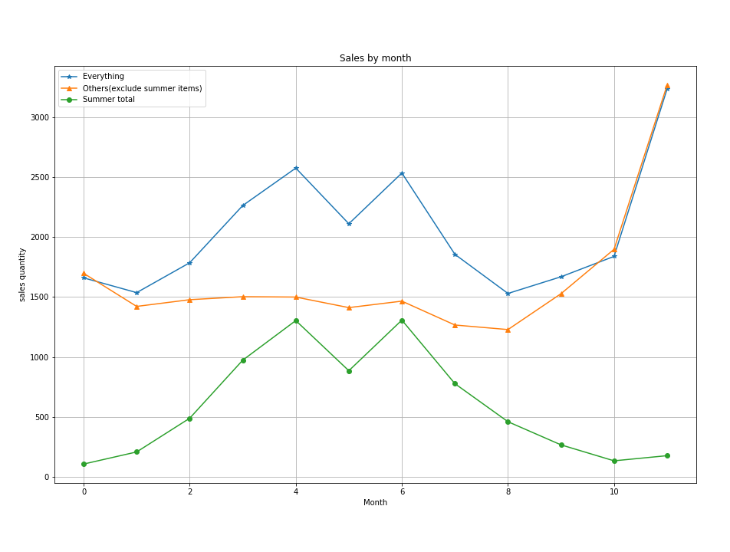
Do products used during summer sell better during warmer months? Hypothesis: Yes
There is a positive correlation between ‘summer items’ and the associated months.
The sales boost is evident during the spring and summer seasons.

Slide 15
Do products used during summer sell better during warmer months? Hypothesis: Yes
Conclusion
The hypothesis is correct.
Ant guard sells better during the summer.
The sales were also high during the spring, and the climb began immediately after winter.

Slide 16
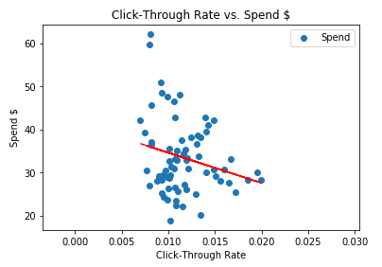
Does click-through rate positively correlate with ad spend in this dataset?
Hypothesis: Yes
Ad Spend is the $ spent per product per day.
There is a lower click-through rate associated with higher spend.
However, earlier we saw that higher ad spend does correlates with higher sales in this dataset. Conversion rate?
The hypothesis was not correct, in this dataset.

Slide 17
Important Learns
This data likely has multiple variable interactions
Output is due to many inputs
Not explored with techniques used
Statistical models for each item may need to be developed. Determining true correlation is more complex, and doesn’t necessarily prove causation.
Use flexible code
Use variables and don’t hard code. Allows for easy switch to new data.
Wrap each step in a function
Allows for reuse of variable names
Makes copy and pasting code easier

Slide 18
Future Considerations
Add more data
Automated reporting through API
Automated adjustments on advertising or price
Thank You!!!

Slide 19
Extra Content

Slide 20

4 Questions Explored
Does advertising in this dataset always increase sales?
Hypothesis: No (Matthew Warner)
Does lowering price in this dataset always increase revenue?
Hypothesis: No (Matthew Warner)
Do products used during summer sell better during warmer months.
Hypothesis: Yes (Emma Li)
Does click through rate positively correlate with ad spend in this dataset?
Hypothesis: Yes (Barrett Ottenberg)

Slide 21
Does advertising in this dataset always increase sales? Hypothesis: No
Average across entire dataset
Cost Per Click (CPC) is the cost when an ad is clicked.
Advertising Process
Bid on keywords
Pay if ad is clicked
Higher bids result in more prominent ad placement. (Ie. Top of Page)
Results in higher Cost Per Click (CPC)

Slide 22
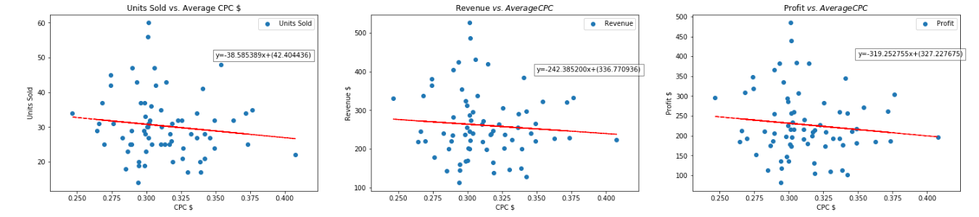
Does advertising in this dataset always increase sales? Hypothesis: No
This figure shows a negative correlation between Cost Per Click and Units Sold, Profit and Revenue.
Higher CPC results in less units sold, less revenue and less profit.
May be worth exploring Higher and Lower Average CPC costs.
Hypothesis was supported by this data.

